Slide 1

Bangladesh Army University of Engineering & Technology Department of Electrical & Electronic Engineering
Lecture: 21
Course Code: EEE 1261
Course Title: Electronic Devices and Circuits
Course Teacher: Ferdous Farjana
Designation: Lecturer, Dept. of EEE, BAUET

Slide 2
Contents
What is Transistor?
Transistor History
What is BJT?
BJT Structure
BJT Terminals
Types of BJTs
Construction of BJT
Operation of BJT
Applications of BJT

Slide 3
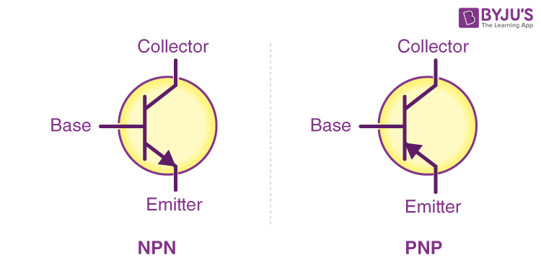
What is Transistor?
The term ‘transistor’ is derived from the words ‘transfer’ and ‘resistor’.
These words describe the operation of a BJT which is the transfer of an input signal from a low-resistance circuit to a high-resistance circuit.
The transistor is a three-layer semiconductor device consisting of either two n- and one p-type layers of material or two p- and one n-type layers of material.
The former is called an npn transistor, and the latter is called a pnp transistor.
Fig. 1: Transistor symbol.

Slide 4
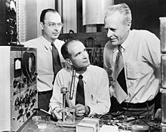
Transistor History
The history of the transistor is a fascinating journey that revolutionized the field of electronics and paved the way for modern technology.
The transistor was invented in 1947 by John Bardeen, Walter Brattain, and William Shockley at Bell Laboratories.
It was a revolutionary device that could amplify electrical signals, making it far more efficient and compact than the vacuum tubes used at the time.
The first successful transistor was a point-contact transistor made from germanium.
This invention marked the beginning of modern electronics, leading to the development of smaller, faster, and more reliable electronic devices like personal computers, smartphones, digital cameras, televisions, portable music players, digital watches, medical devices, video game consoles, automobiles, internet routers, and modems.
Bardeen, Brattain, and Shockley were awarded the Nobel Prize in Physics in 1956 for this groundbreaking work.
From left: John Bardeen, William Shockley and Walter Brattain, the inventors of the transistor in 1947.

Slide 5
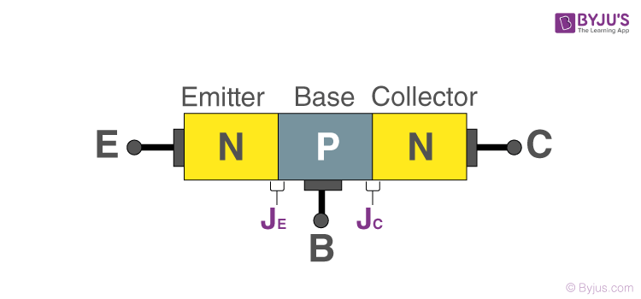
What is BJT?
A Bipolar Junction Transistor (BJT) is a three-terminal semiconductor device that consists of two p-n junctions which are able to amplify or magnify a signal.
It is a current-controlled device.
A BJT is a type of transistor that uses both electron and hole charge carriers.
The three terminals of the BJT are the base, the collector, and the emitter.
Fig. 2: Bipolar junction transistor.

Slide 6
What is BJT?
A signal of a small amplitude applied to the base is available in the amplified form at the collector of the transistor.
This is the amplification provided by the BJT.
Note that it does require an external source of DC power supply to carry out the amplification process.
BJTs are used for amplification and switching applications in various electronic devices.

Slide 7
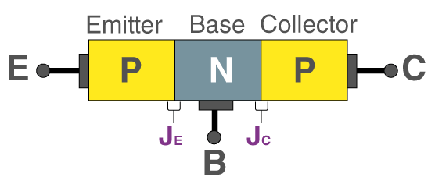
BJT Structure
BJT Construction: A BJT consists of three layers of semiconductor material, each capable of carrying a current.
These layers form two junctions, hence the name “bipolar junction transistor”.
NPN BJT: Consists of a layer of p-type material sandwiched between two n-type materials.
PNP BJT: Consists of a layer of n-type material sandwiched between two p-type materials.
(a)
(b)
Fig. 3: BJT: (a) NPN, (b) PNP.

Slide 8
BJT Terminals
Emitter (E): The region that emits charge carriers (electrons or holes) into the base.
Base (B): The middle layer that controls the flow of carriers from the emitter to the collector.
Collector (C): The region that collects the charge carriers from the base.

Slide 9
Types of BJTs
NPN Transistor: More common in applications due to the higher mobility of electrons compared to holes (electron mobility is about 2.8 times higher than hole mobility).
PNP Transistor: Used when the circuit design requires it, with current flow and voltage polarities opposite to those in an NPN transistor.

Slide 10
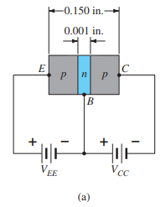
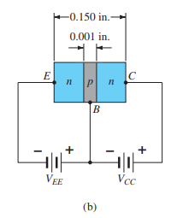
Construction of BJT
Both the pnp and npn transistors are shown in Fig. 4 with the proper dc biasing.
The dc biasing is necessary to establish the proper region of operation for ac amplification.
The emitter layer is heavily doped, with the base and collector only lightly doped.
The outer layers have widths much greater than the sandwiched p- or n-type material.
For transistors, the ratio of the total width to that of the center layer is 0.150/0.001 = 150:1.
Fig. 4: Types of transistors: (a) pnp; (b) npn.

Slide 11
Construction of BJT
The doping of the sandwiched layer is also considerably less than that of the outer layers (typically, 1:10 or less).
This lower doping level decreases the conductivity (increases the resistance) of this material by limiting the number of “free” carriers.
For the biasing shown in Fig. 4, the terminals have been indicated by the capital letters E for the emitter, C for the collector, and B for the base.
The abbreviation BJT, from bipolar junction transistor, is often applied to this three-terminal device.
The term bipolar reflects the fact that holes and electrons participate in the injection process into the oppositely polarized material.
If only one carrier is employed (electron or hole), it is considered a unipolar device i.e., Schottky diode.

Slide 12
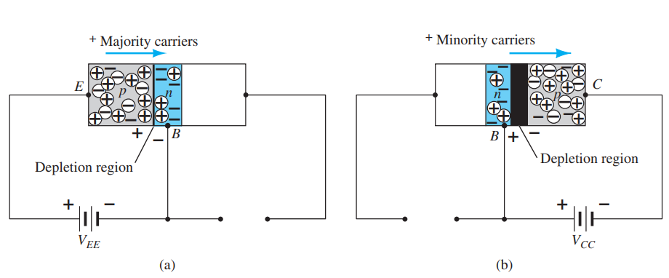
Operation of BJT
The basic operation of the transistor will now be described using the pnp transistor of Fig. 5.
The operation of the npn transistor is exactly the same if the roles played by the electron and hole are interchanged.
In Fig. 5: (a) the pnp transistor has been redrawn without the base-to-collector bias.
Note: There are similarities between this situation and that of the forward-biased diode.
The depletion region has been reduced in width due to the applied bias, resulting in a heavy flow of majority carriers from the p- to the n-type material.
Fig. 5: Biasing a transistor: (a) forward-bias; (b) reverse-bias.

Slide 13
Operation of BJT
Let us now remove the base-to-emitter bias of the pnp transistor of Fig. 5: (a) as shown in Fig. 5: (b).
Consider the similarities between this situation and that of the reverse-biased diode.
Recall that the flow of majority carriers is zero, resulting in only a minority-carrier flow, as indicated in Fig. 5: (b).
In summary, therefore: One p–n junction of a transistor is reverse-biased, whereas the other is forward-biased.
Fig. 5: Biasing a transistor: (a) forward-bias; (b) reverse-bias.

Slide 14
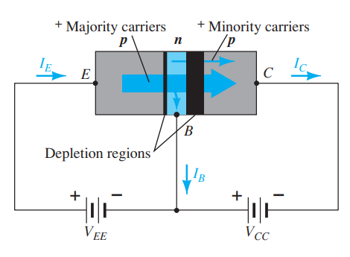
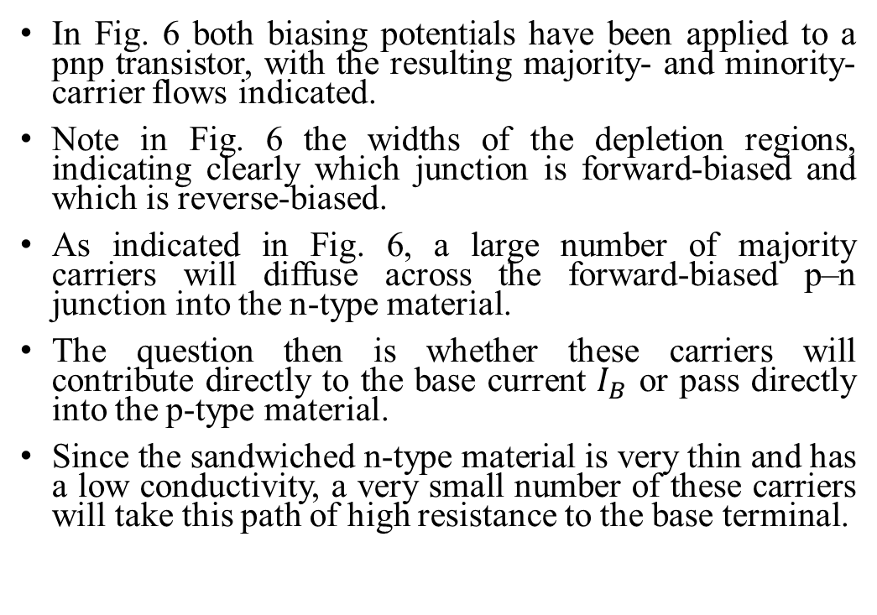
Operation of BJT
In Fig. 6 both biasing potentials have been applied to a pnp transistor, with the resulting majority- and minority-carrier flows indicated.
Note in Fig. 6 the widths of the depletion regions, indicating clearly which junction is forward-biased and which is reverse-biased.
As indicated in Fig. 6, a large number of majority carriers will diffuse across the forward-biased p–n junction into the n-type material.
The question then is whether these carriers will contribute directly to the base current $I_{B}$ or pass directly into the p-type material.
Since the sandwiched n-type material is very thin and has a low conductivity, a very small number of these carriers will take this path of high resistance to the base terminal.
Fig. 6: Majority and minority carrier flow of a pnp transistor.

Slide 15
Operation of BJT
The magnitude of the base current is typically on the order of microamperes, as compared to milliamperes for the emitter and collector currents.
The larger number of these majority carriers will diffuse across the reverse-biased junction into the p-type material connected to the collector terminal as indicated in Fig. 6.
The reason for the relative ease with which the majority carriers can cross the reverse-biased junction is easily understood if we consider that for the reverse-biased diode, the injected majority carriers will appear as minority carriers (holes) in the n-type material.
In other words, there has been an injection of minority carriers (holes) into the n-type base region material.
Combining this with the fact that all the minority carriers (holes) in the depletion region will cross the reverse-biased junction of a diode accounts for the flow indicated in Fig. 6.

Slide 16
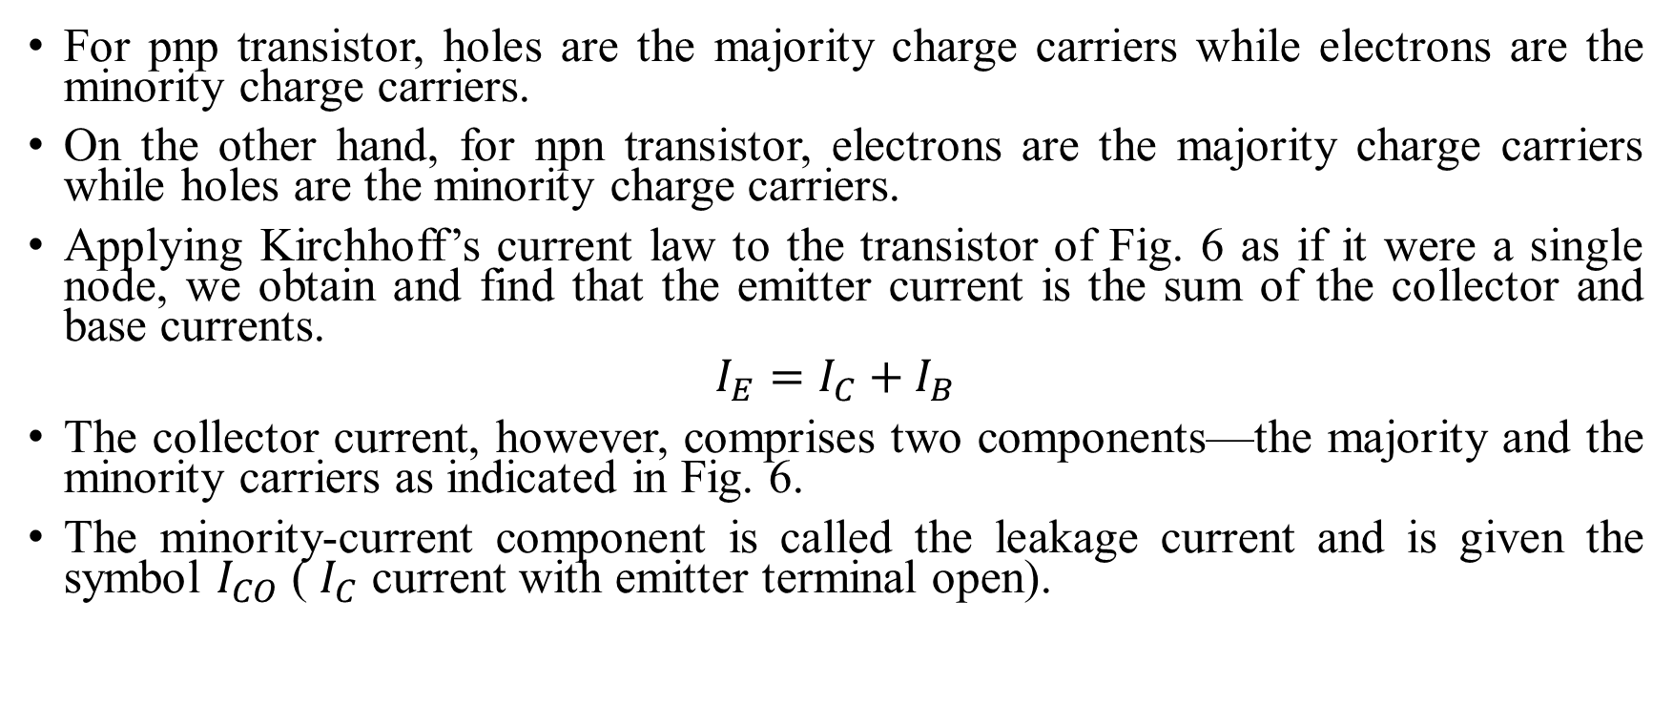
Operation of BJT
For pnp transistor, holes are the majority charge carriers while electrons are the minority charge carriers.
On the other hand, for npn transistor, electrons are the majority charge carriers while holes are the minority charge carriers.
Applying Kirchhoff’s current law to the transistor of Fig. 6 as if it were a single node, we obtain and find that the emitter current is the sum of the collector and base currents.
$$I_{E}=I_{C}+I_{B}$$
The collector current, however, comprises two components—the majority and the minority carriers as indicated in Fig. 6.
The minority-current component is called the leakage current and is given the symbol $I_{CO}$ ( $I_{C}$ current with emitter terminal open).

Slide 17
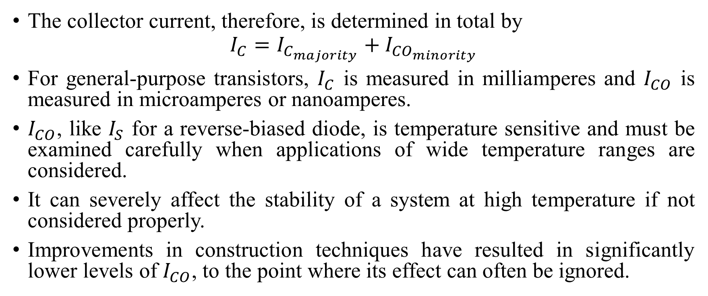
Operation of BJT
The collector current, therefore, is determined in total by
$$I_{C}=I_{C_{majority}}+I_{{CO}_{minority}}$$
For general-purpose transistors, $I_{C}$ is measured in milliamperes and $I_{CO}$ is measured in microamperes or nanoamperes.
$I_{CO}$, like $I_{S}$ for a reverse-biased diode, is temperature sensitive and must be examined carefully when applications of wide temperature ranges are considered.
It can severely affect the stability of a system at high temperature if not considered properly.
Improvements in construction techniques have resulted in significantly lower levels of $I_{CO}$, to the point where its effect can often be ignored.

Slide 18
Applications of BJT
Amplifiers: Used in audio equipment, radio frequency circuits, and other analog applications to amplify weak signals.
Switching Circuits: Common in digital circuits, where they act as on/off switches.
Oscillators and Signal Generators: BJTs are also used in generating and modulating signals.
Signal Modulation: BJTs are used in communication systems to modulate carrier waves, allowing the transmission of information over long distances.
Sensor Circuits: BJTs are used in circuits that detect temperature changes and convert them into measurable electrical signals, which are crucial in climate control systems and safety devices, and they can also be part of light-sensitive circuits that detect changes in light intensity, used in automatic lighting, cameras, and optical communication systems.

Slide 19
Reference Books
Electronic Devices and Circuit Theory: Robert L. Boylestad.
Microelectronic Circuits: Sedra Smith.
Electronic Devices and Circuits: Millman and Halkias.

Slide 20

THANK YOU

